Slide 1
AI Powered Lead Generation & Sales Automation Platform

Slide 2

Department of Computer Science & Engineering (Artificial Intelligence & Machine Learning)
A.P. Shah Institute of Technology, G.B.Road, Kasarwadavli, Thane(W), Mumbai-400615, UNIVERSITY OF MUMBAI
Academic Year 2025-2026

Slide 3
Computer Science & Engineering Artificial Intelligence and Machine Learning By Durvesh Kanade (22106013) Aaryaman Kattali (22106077) Vaishnavi Dumbre (22106115) Ritik Pandey (22106054) Under the Guidance of Prof. Viki Patil

Slide 4
Outline
Introduction
Literature Survey of the existing systems
Limitations of the existing systems
Problem statement
System Design
Technologies and methodologies
Implementation
Outcome
References

Slide 5
Introduction
End-to-end AI-powered lead generation and sales automation platform for GSBG's Salesforce consulting services, targeting the real estate industry.
Combines custom AI models with Salesforce Agentforce to automatically identify, qualify, and nurture prospects through personalized outreach campaigns.
Features complete website redesign with dynamic UI/UX to deliver conversion-focused content and achieve 90% reduction in manual prospecting.
Built on modern Next.js/Python with seamless Salesforce CRM and email service integration for real-time automation.
This Project aligns with SDG goal 8 and 9.

Slide 6
Literature Survey of Existing System
Title | Year | Author | Description | Limitation
Evolution of CRM: How Salesforce Einstein AI Simplifies Predictive Analytics | 2025 | Shivakrishna Deepak Veeravalli | Predictive analytics for CRM systems. Enhanced dashboards with automated insights. | Overview-focused without technical depth. No real-time engagement or domain-specific implementation
Grounded Persuasive Language Generation for Automated Marketing | 2025 | Jibang Wu, Chenghao Yang, Simon Mahns, Yi Wu, Chaoqi Wang, Hao Zhu, Fei Fang, Haifeng Xu | Personalized content generation using LLMs. Produces superior quality vs human content. | Content-only focus without CRM integration. No lead routing or handoff mechanisms. Limited campaign effectiveness evaluation
Optimising Lead Qualification through Machine Learning | 2024 | Josephine V L, Helen, Moorthy, Vasudevan, Sai, Chandana, Joji, Bindhia | Uses ML algorithms for lead scoring. 53.1% accuracy improvement achieved. Prioritizes accuracy over real-time engagement. | Low accuracy (53.1%). No real-time processing. Manual intervention required. Limited dataset generalizability

Slide 7
Literature Survey of Existing System
Title | Year | Author | Description | Limitation
AI-Powered Decision-Making: Enhancing BI with Tableau and Einstein Discovery | 2024 | Bobby Brill | Combines Tableau with Einstein for business intelligence. Enhances decision-making speed. Focused on analytics, not proactive lead capture. | Reactive approach without proactive engagement. Platform-dependent with integration complexity
Marketing Automation & AI Report 2024: B2B Lead Management | 2024 | Darius Zumstein Michèle Rettenmund Marc Gasser Virginie Cantin Urs Thüring Daniel Kölle | 56% of companies use manual lead scoring. Observational study on automation maturity. No ML-based solutions implemented. | Survey-only without technical solutions. No ML implementation or validation
Next-Gen CRM Sales and Lead Generation with AI | 2023 | Anitha Peddireddy, Kiran Peddireddy | Uses NLP and predictive analytics. Improves overall CRM functionality. Lacks real estate domain specificity. | Theoretical approach without deployment validation. Missing performance metrics and scalability analysis

Slide 8
Literature Survey of Existing System
Title | Year | Author | Description | Limitation
AI-Driven Social Media Analytics for eCommerce Advertising | 2023 | Abeer Mohamed | Applied to e-commerce platforms. Boosts user engagement rates. Not tailored for real estate domain. | Platform-specific without domain adaptation. No B2B integration or ROI analysis
Exploring The Impact of Chatbots on Consumer Sentiment in Retail | 2021 | Anh D. Tran , Jason I. Pallant , Lester W. Johnson | Enhances customer engagement in retail. Based on Technology Acceptance Model (TAM). Lacks B2B and real estate applications. | Retail-only scope without B2B applications. No conversion or business impact metrics
Augmenting Customer Support with an NLP-based Receptionist | 2021 | André Barbosa, Alan Godoy | Portuguese NLP model with 85% accuracy. Achieves human-level support performance. Limited to customer support, not lead generation. | Support-only without lead generation. Language-specific limitations. Small unbalanced dataset
Language Models are Few-Shot Learners (GPT-3) | 2020 | Tom B. Brown, Benjamin Mann, Nick Ryder, Melanie Subbiah, Prafulla Dhariwal | Handles diverse general NLP tasks. Delivers human-level language performance. Not optimized for CRM applications. | General-purpose without CRM optimization. No domain-specific tuning or sales workflow integration

Slide 9
Limitations of Existing System
Current lead-generation relies on manual research and generic campaigns that are slow and hard to scale.
Static website lacks personalization, conversion optimization, and 24/7 automated engagement capabilities.
No real-time chatbot leads to delayed inquiries and sales team lacks prospect intelligence.
Manual processes, low conversions, and slow follow-up fail to meet growth targets, requiring automated solutions.

Slide 10
Problem Statement
GSBG is facing challenges in generating and converting leads for its Salesforce services in the real estate and related sectors. The main reason for this issue is the heavy reliance on manual client acquisition methods, which are time-consuming, require significant effort, and are difficult to scale. These limitations reduce the ability to identify and engage potential clients effectively, leading to lower conversion rates. Hence, there is a need for an automated and data-driven lead generation system that can streamline acquisition processes, improve targeting accuracy, and increase overall conversion efficiency.

Slide 11
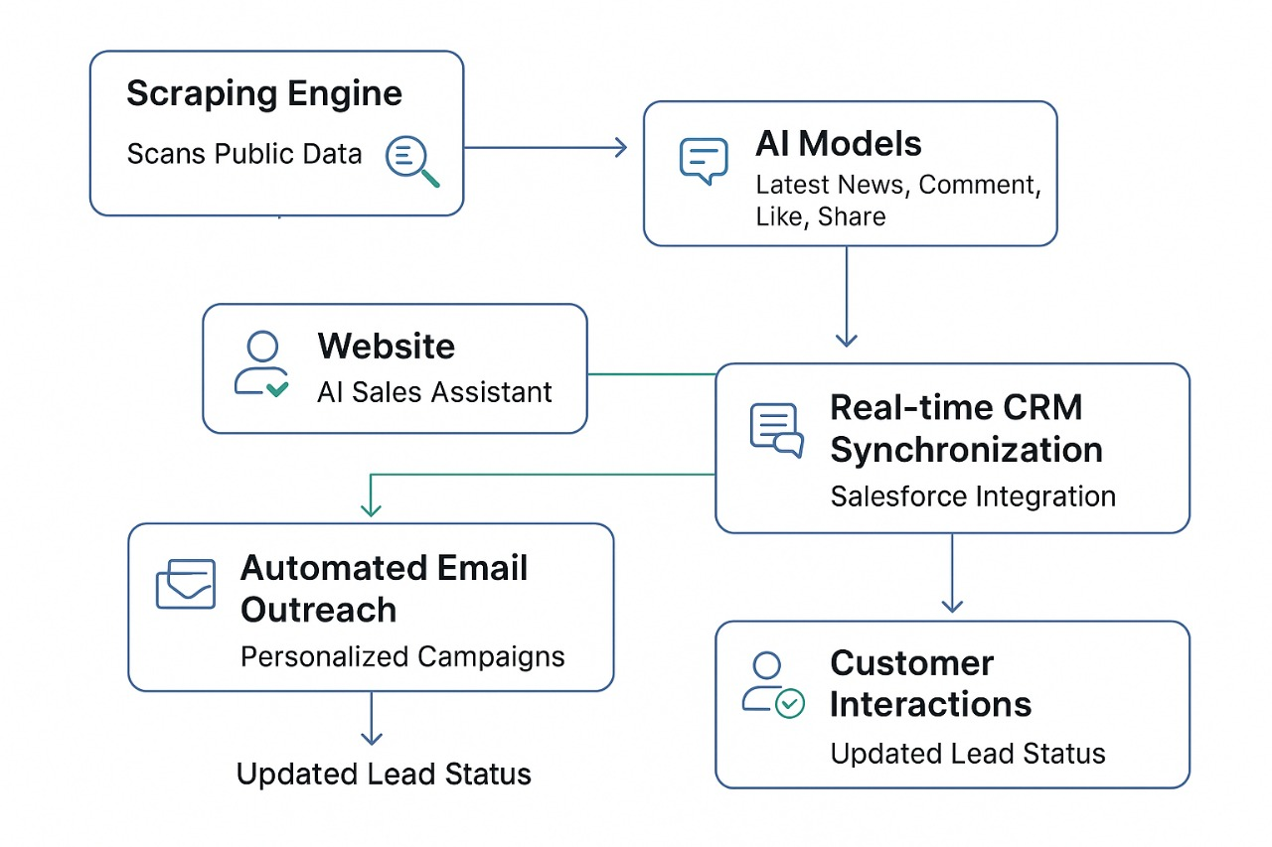
System Design

Slide 12
System Design
Frontend
Provides server-side rendering (SSR) and static site generation (SSG) for fast load times and SEO optimization
Powers 3D animations and hover effects, creating a modern, interactive user experience.
Backend
Handles API routing, user session management, and communication with AI services.
Orchestrates requests between frontend, chatbot, and database.

Slide 13
System Design
Chatbot + Messaging
Python service handles chatbot conversations.
Messages are refined through Predefined rules and AI model for professional, grammatically correct responses .
Logged-in leads can receive direct messages, nurturing them toward conversion.
Lead Classification
Runs a local LLM (Mistral) via Ollama to classify leads as Hot / Warm / Cold.
This avoids traditional ML models – instead it’s prompt-based classification.

Slide 14
System Design
Database (PostgreSQL)
Stores lead details, chat history, and messaging logs.
Lightweight, reliable, and easy to deploy.
Future Integration (Agentforce)
Salesforce’s Agentforce AI will enable automated CRM workflows:
Handoff of leads to CRM.
Autonomous AI agents scheduling meetings, sending follow-ups, etc.

Slide 15
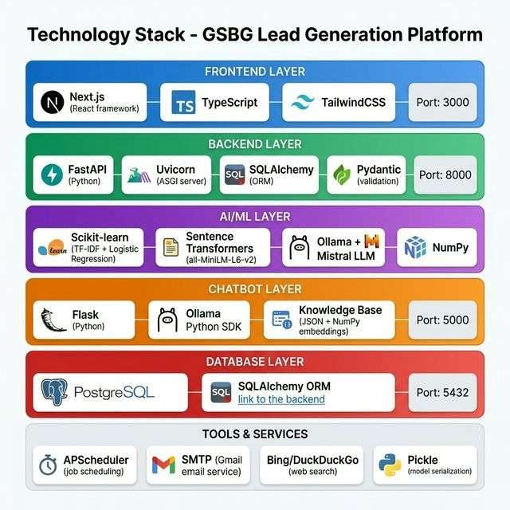
Technologies and methodologies

Slide 16
Technologies and methodologies
Next.js, React.js & Tailwind CSS
Modern frontend stack for fast, SEO-friendly, and highly responsive user interfaces.
Supports server-side rendering (SSR) to improve performance and Lighthouse scores.
Node.js & Express.js
Lightweight backend runtime and framework replacing Nest.js.
Provides modular routing and structured APIs for seamless communication between the UI and AI layers.

Slide 17
Technologies and methodologies
Python, Scikit-learn & PyTorch
Manages the core backend AI logic and data preprocessing.
Powers the predictive lead scoring algorithms (Random Forest/XGBoost).
Mistral AI, Ollama & Hugging Face
Local LLM hosting and embedding generation for the conversational chatbot.
Uses prompt engineering and RAG architecture to assign Hot/Warm/Cold labels.
Keeps sensitive lead data completely private by running models securely.

Slide 18
Technologies and methodologies
PostgreSQL & MongoDB
Replaces SQLite for enterprise-grade scalability.
PostgreSQL handles structured CRM data, while MongoDB stores unstructured chat logs and interaction history.
Salesforce CRM
The ultimate destination for the data, enabling autonomous lead management and proactive sales actions.
Docker & AWS
Ensures reliable, containerized application deployment on highly scalable cloud infrastructure.

Slide 19
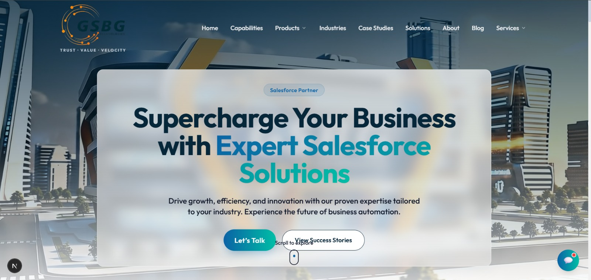
Implementation
Home page

Slide 20
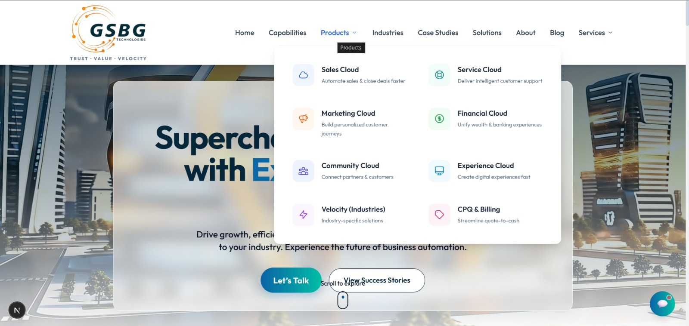
Implementation
Products of website

Slide 21
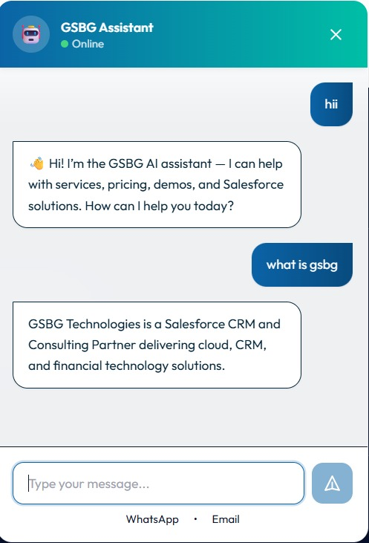
Implementation
Chatbot Lead Qualification and Interaction

Slide 22
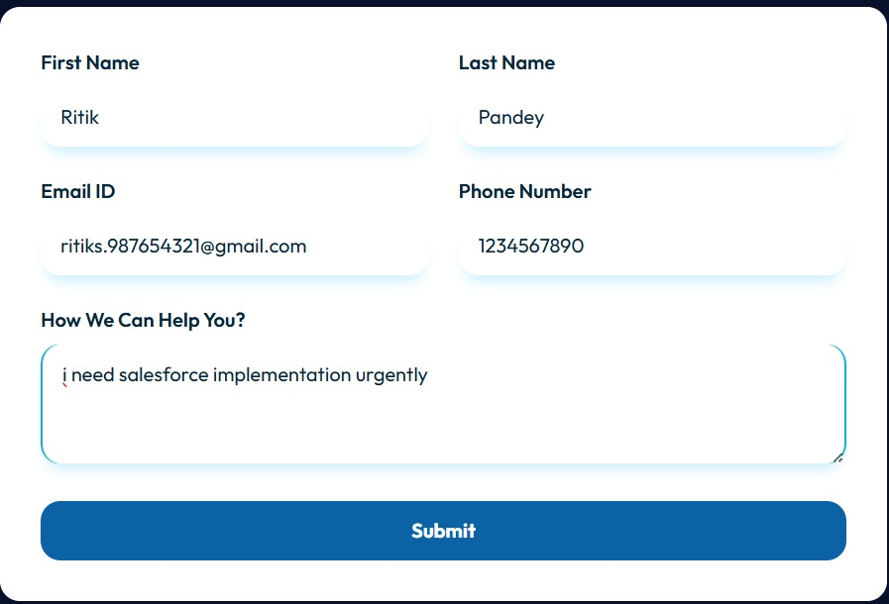
Implementation
Email Generation

Slide 23
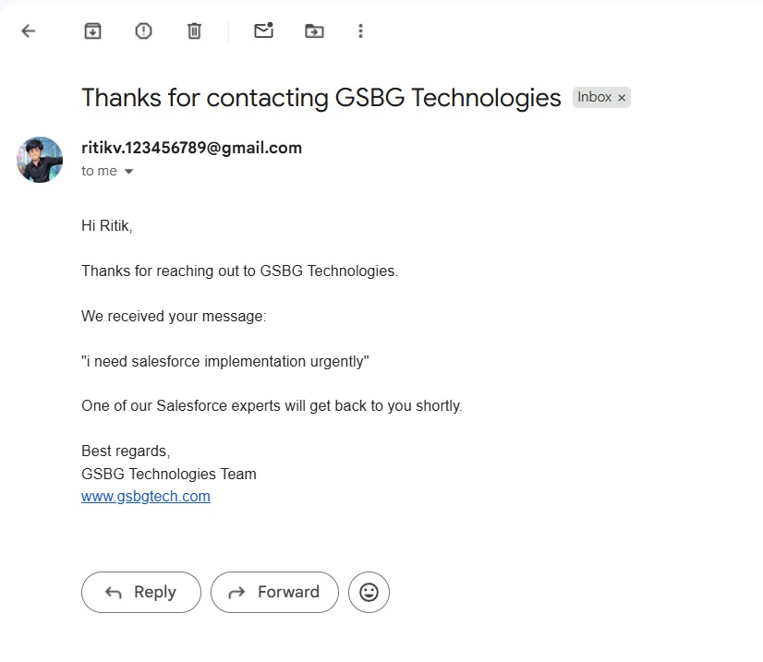
Implementation
Automated Follow-up Email via SMTP Integration

Slide 24
Outcome
97% Qualification Accuracy: The hybrid machine learning model accurately identifies high-value leads, resulting in a 28% increase in actual sales conversions.
42% Faster Response Times: Initial engagement delays were drastically reduced from an average of 14 hours down to under 3 minutes.
Real-Time AI Automation: The integrated Agentforce chatbot (Mistral 7B + RAG) successfully handles complex B2B interactions with a hallucination rate of less than 2%.
Unified CRM Integration: All lead data, scoring, and interactions are automatically synced to Salesforce in real time, creating a centralized "single source of truth" for the sales team.

Slide 25
References
[1] Shiva Krishna & Deepak Veeravalli, The Evolution of CRM: How Salesforce Einstein AI Simplifies Predictive Analytics, International Research Journal of Modern Engineering and Technology, Volume 10, Issue 3, Pages 255–270, 2025.
[2] Navdeep Singh & Daisy Adhikari, AI-Driven Social Media Analytics for eCommerce Advertising, International Research Journal of Engineering and Technology, Volume 10, Issue 12, Pages 509–515, 2025.
[3] André Barbosa & Alan Godoy, Augmenting Customer Support with an NLP-based Receptionist, arXiv preprint arXiv:2112.01959, 2025.
[4] Helen Josephine V & Moorthy, Optimising Lead Qualification through Machine Learning: A Customer Data-Driven Approach, Advances in Management, Volume 10, Issue 3, Pages 255–270, 2024.
[5] Darius Zumstein, Marketing Automation & AI Report 2024: Tactics & Tools of AI-Based Lead Generation, ZHAW School of Management and Law, 2024.

Slide 26
References
[6] Salesforce, Agent-Powered Analytics Deliver Data and Insights in the Flow of Work, Salesforce News, 2024.
[7] Navdeep Singh & Daisy Adhikari, AI-Driven Social Media Analytics for eCommerce Advertising, International Research Journal of Engineering and Technology, Volume 10, Issue 12, Pages 509–515, 2023.
[8] Marketing Automation & AI Report 2024: Tactics & Tools of AI-Based Lead Generation, ZHAW School of Management and Law, 2023.
[9] André Barbosa & Alan Godoy, Augmenting Customer Support with an NLP-based Receptionist, arXiv preprint arXiv: 211201959, 2021.
[10] Anh D. Tran, Jason Pallant & Lester W. Johnson, Exploring the Impact of Chatbots on Consumer Sentiment and Expectations in Retail, Journal of Retailing and Consumer Services, Volume 63, Article 102284, 2021.
[11] Brown et al., Language Models are Few-Shot Learners (GPT-3), arXiv preprint arXiv:2005.14165,2020.

Slide 27
THANK YOU!

